Slide 1
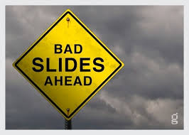


Slide 2


Slide 3
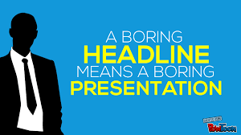

Slide 4
Effective Presentations Skills

Slide 5


#1 Fear
Feared More Than Death!
THE FACTS: Shaky hands, blushing cheeks, memory loss, nausea, and knocking knees
NORMAL!

Slide 6
Causes of the Anxiety
Vocabulary
Fear of the Unknown OR Loss of Control
No Backup Plan
No Enthusiasm For Subject
Focus & Attention

Slide 7
Why Give A Presentation?
Three Main Purposes
Inform
Persuade
Educate

Slide 8
Definitions
Presentation
“Something set forth to an audience for the attention of the mind “
Effective
“…producing a desired result”
Source:Communication for Business by Shirley Taylor

Slide 9
start
Anecdotes
Jokes
Facts
Arousing Qs
quotes

Slide 10
Brand yourself
Define your brand
Set your brand goals
Look the part
Sound the part
Act the part
Relationship breaking/breaking

Slide 11
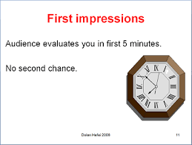

Slide 12
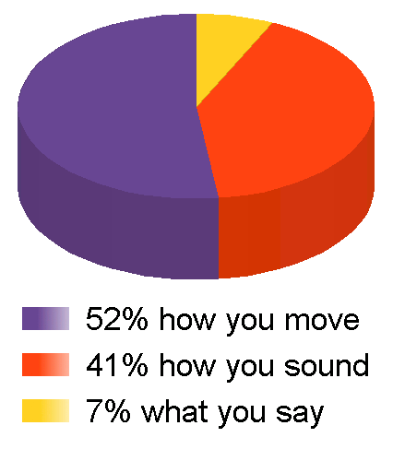

Slide 13
Face to face communication
55% NON VERBAL
37% TONE OF VOICE
8% WORDS

Slide 14
Agenda
Introduction
Planning Your Presentation
The Presentation Sequence
Creating Effective Visual Aids
Presentation Techniques
Practice

Slide 15
Presentation(who is favouring whom?)
Opportunity to communicate your point of view
Informal /formal /impromptu/prepared/individual/group
We make presentations to??:

Slide 16
4 important points
Planning-know-Analyse-size
Writing-hard facts-Visual Aids
Completing-PRACTICE
Deliver-handling questions

Slide 17
Organising the Content Language – Introduction
Focusing
Handling Questions
Closing Non Verbal Skills -Voice Quality, Volume and Pace

Slide 18
Ask yourself
Do you know the knowledge level
Why you are here?
What sort of work you have done in this area?
Impact
How long?
Relevant info/check your facts/figs/Nos

Slide 19
Know their demographics
How many people will there be in the audience?
Ohp,ppt,audio,microphone

Slide 20
5 Commandments
Speak to your audience
Listen
Respond to their reactions
Adjust and adapt
Pause and humour

Slide 21
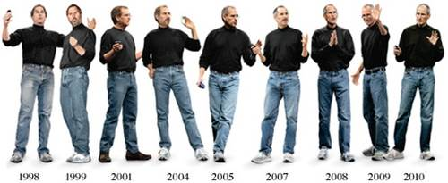

Slide 22
a) Audibility
b) Pace of the presentation
c) Fluency
d)Tone and Energy
e) Eye Contact
f) Body Language and Gesture
g) Appropriateness to the Audience
h) Structure and Cohesion
i) Use of Visual Aids
j) Content
k) Is the depth of the content sufficient?
l) Argument
m) Creativity

Slide 23
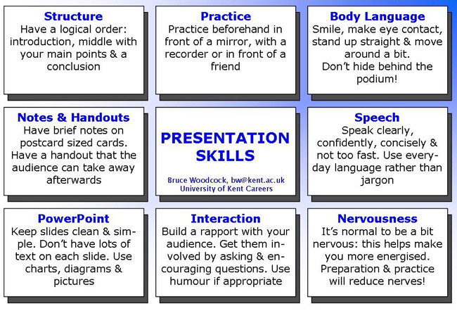

Slide 24
Do not assume that the listener has prior knowledge about the subject
Appropriate time
Organise chronology
Simple clear language
Don’t be irrelevant
Watch for immediate expressions&gestures

Slide 25
Allow the listeners to clarify themselves if not clear
Repeat if subject is complicated
Know the needs
Prepare your material thoroughly
Be solemn if topic is serious
Speak slowly,enunciate clearly

Slide 26
“Great speakers aren’t born, they are trained.”
Presenting is a Skill…
Developed through experience
and training.
Source: http://www.hplearningcenter.com

Slide 27
Some reflections and recapitulations

Slide 28
Effective Presentations
Control Anxiety – Don’t Fight It
Audience Centered
Accomplishes Objective
Fun For Audience
Fun For You
Conducted Within Time Frame

Slide 29
Part 2:
Planning Your Presentation

Slide 30
Planning Your Presentation
Determine Purpose
Assess Your Audience
  “Success depends on your ability to reach your audience.”
  Size
  Demographics
  Knowledge Level
  Motivation

Slide 31
Planning A Presentation
Plan Space
  Number of Seats
  Seating Arrangement
  Audio/Visual Equipment
  Distracters
What Day and Time?
  Any Day!
  Morning

Slide 32
More Planning
Organization
  Determine Main Points (2-5)
  Evidence
  Prepare Outline

Slide 33
Organizing Your Presentation
Organizational Patterns
Topical
Chronological
Problem/Solution
Cause/Effect

Slide 34
Presentation Outline
Keyword Reminders
Conversational Flow
Flexibility
More Responsive to Audience

Slide 35
Part 3:
The Presentation Sequence

Slide 36


#1: Build Rapport
… relation marked by harmony or affinity
  Audience members who trust you and feel that you care
Start Before You Begin
  Mingle; Learn Names
  Opportunity to reinforce or correct audience assessment
  Good First Impression
People Listen To People They Like

Slide 37
#2: Opening Your Presentation
Introduce Yourself – Why Should They Listen
Get Attention, Build More Rapport, Introduce Topic
  Humor
  Short Story
  Starling Statistic
  Make Audience Think
  Invite Participation
Get Audience Response

Slide 38

#2…Completing the Opening
Clearly Defining Topic
If Informative…
  Clear parameters for content within time
If Persuasive…
  What’s the problem
  Who cares
  What’s the solution
Overview

Slide 39
#3: Presenting Main
Points (Solution)
Main Point-Transition-Main Point-Transition-MainPoint…..
Supporting Evidence
Examples
Feedback & Questions From Audience
Attention to, and Focus on, Audience (Listening)

Slide 40
#4: Concluding Your Presentation
Goal
Inform audience that you’re about to close
Summarize main points
Something to remember or call-to-action
Answer questions
“Tell ’em What You Told ‘em.”

Slide 41
Part 4: Effective
Presentation Techniques

Slide 42
Presentation Style
3 Elements
Vocal Techniques
  Loudness
  Pitch
  Rate
  Pause
Deviations From the Norm for Emphasis

Slide 43
Presentation Style (con’t)
3 Elements
Body Language
  Eye Contact, Gestures, Posture
Use of Space
  Can Everyone See You?
  Movement

Slide 44
Common Problems
Verbal fillers
  “Um”, “uh”, “like”
  Any unrelated word or phrase
Swaying, rocking, and pacing
Hands in pockets
Lip smacking
Fidgeting
Failure to be audience-centered

Slide 45
5 Presentation Tips
Smile
Breathe
Water
Notes
Finish On Or Under Time

Slide 46
Part 5:
Creating Effective Visual Aids

Slide 47
Visual Aids
Enhance Understanding
Add Variety
Support Claims
Lasting Impact

Slide 48
Visual Aids - Examples
PowerPoint Slides
Overhead Trans
Graphs/Charts
Pictures
Films/Video
Flip Charts
Sketches

Slide 49
Visual Aids Should…
Supplement presentation
Outline of main points
Serve audience’s needs, not speaker’s
Simple and clear

Slide 50
Main Point 1: The Purpose of Using Visual Aids
Visual aids support your ideas and improve audience comprehension of your presentation
Visual aids add variety to your presentation by giving the audience a break from listening and letting the see something
Visual aids help illustrate complex ideas or concepts and are helpful in reinforcing your ideas

Slide 51
Visual Aids
Improve comprehension
Add variety
Illustrate complex ideas

Slide 52
Be Visible
Titles should be 38-44 pt. font size
Text should be 28 pt font size
Use color wisely
  Contrasting colors

Slide 53


Slide 54


